Slide 1
HARDWARE INTERFACING

Slide 2
Circuits
1] LED circuit
2] Buzzer circuit
3] Relay circuit
4] PIR logic circuit
5] ultrasonic

Slide 3
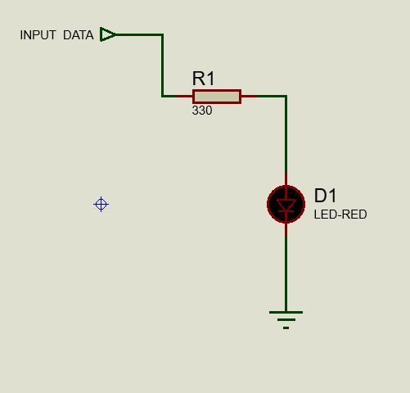
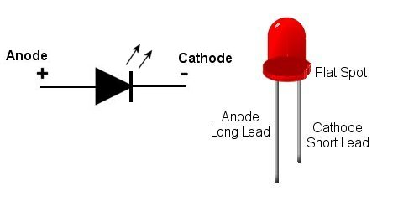
input data is connected to pin gpio 2)Ground is connected to GND pin

Slide 4
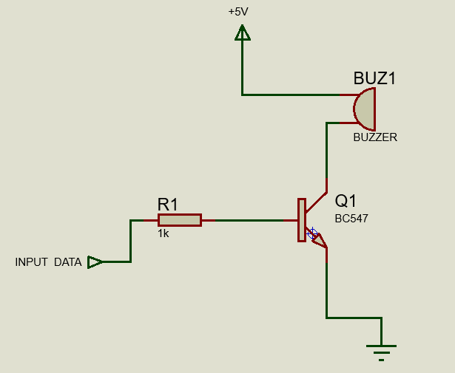
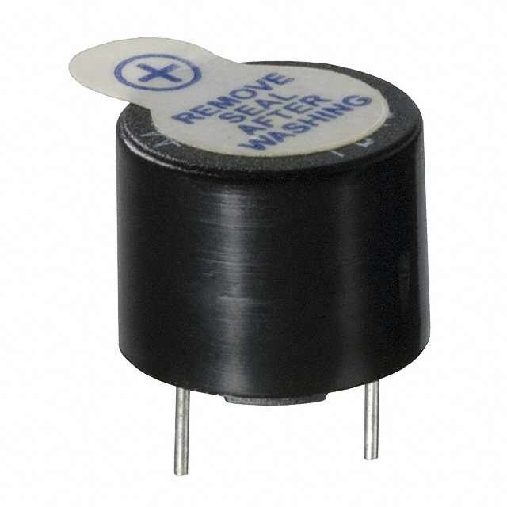
1)Input data is connected to gpio pin 3

Slide 5
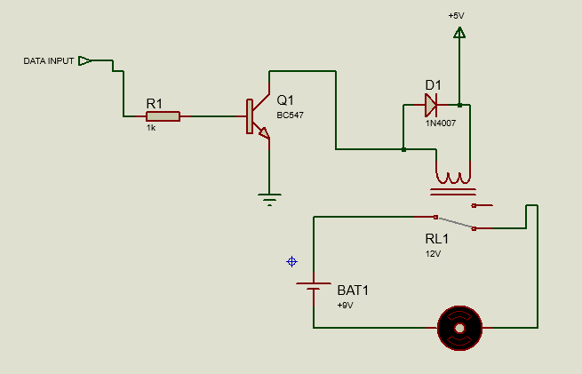
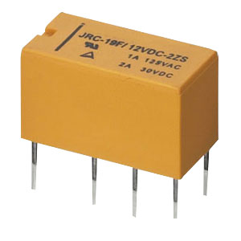
Data input is connected to gpio 3

Slide 6

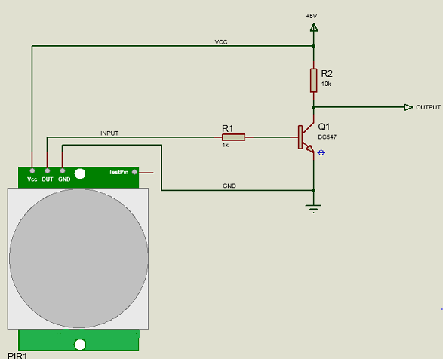
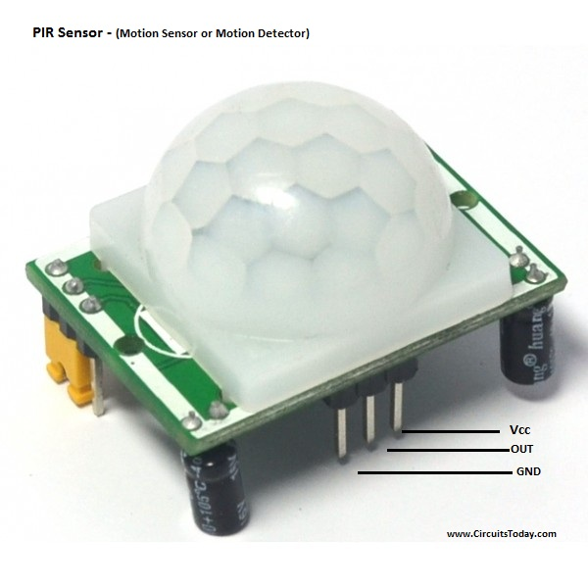
1)PIR output pin is connected as input to base of Q1 2)PIR VCC is connected to collector of Q1 3)PIR GND is connected to emitter of Q1 4)output is taken from in between to 10k resistor and collector of Q1

Slide 7
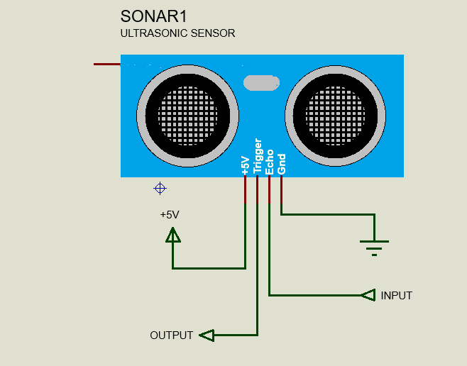
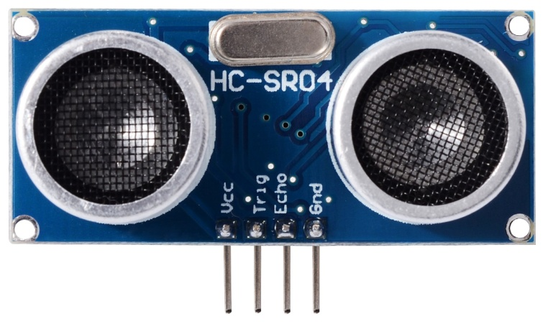

Slide 8
THANK YOU…

